Slide 1

Major crime indicator for the city of toronto

Slide 2

Overview of the database
The Major Crime Indicator dataset contains all significant crimes that were reported to Toronto Police Service between 2014 and 2022. The information is broken down by victim or offence. The dataset provides information about the attributes of the incident, such as the types of crime, the scene, and the time and date it happened when it was reported.

Slide 3

Why did we choose this dataset?
We have picked the major crime incidence statistics to make conclusions about the kind of crimes that have been reported to the Toronto Police during the past few years. The public may benefit from these insights for their own safety while also receiving clear, comprehensible findings that will enable them to determine whether or not society is getting safer overall. The investigation and discussion of the potential explanations for the rise in crime are sparked by the audience’s exploration of the analysis of this dataset’s public safety implications.

Slide 4
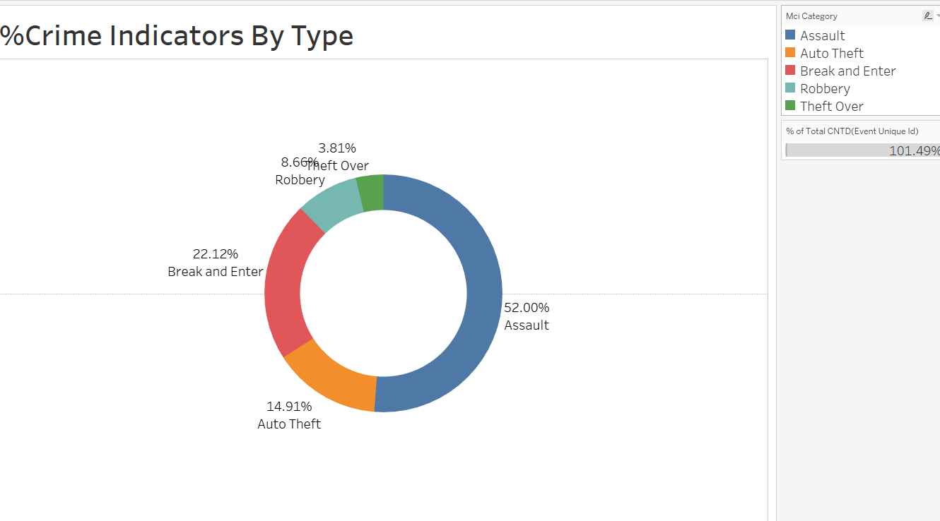
which is the highest crime committed in the city of Toronto?
Interpretation of the chart
The Donut chart shows the distribution of the type of crime committed. Assault was the largest crime, 52%
The second highest crime is Break and Enter which is about 22.12%. out of all the crimes. Theft Over is the lowest crime which is 3.81%

Slide 5
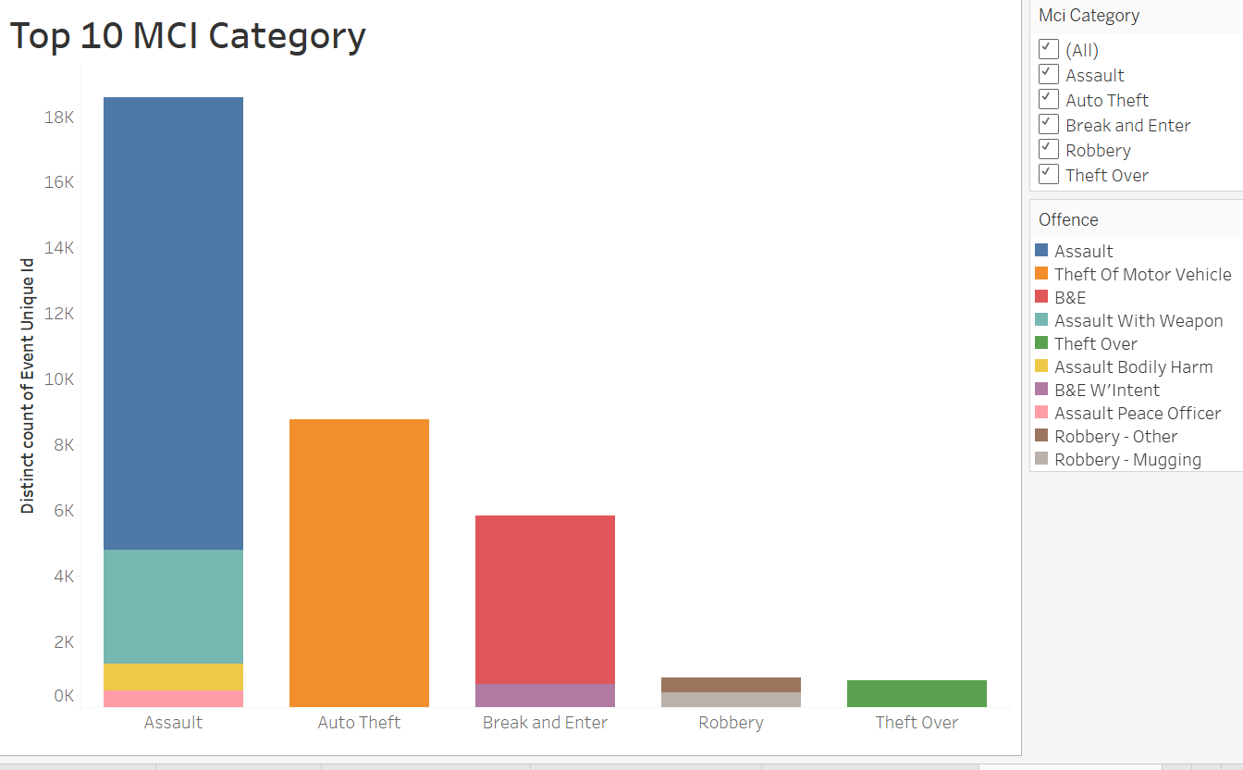
Which crime is the highest?
Interpretation
Bar chart shows Toronto's top 10 Major Crime indicators. Assualt is the highest crime which counts to 13,784. Theft of Motor Vehicle which falls under Auto Theft Category counts to 8765.
The lowest crime committed in the city of Toronto for the year 2022 is the Robbery-Mugging which falls under the category of robbery which is 447

Slide 6
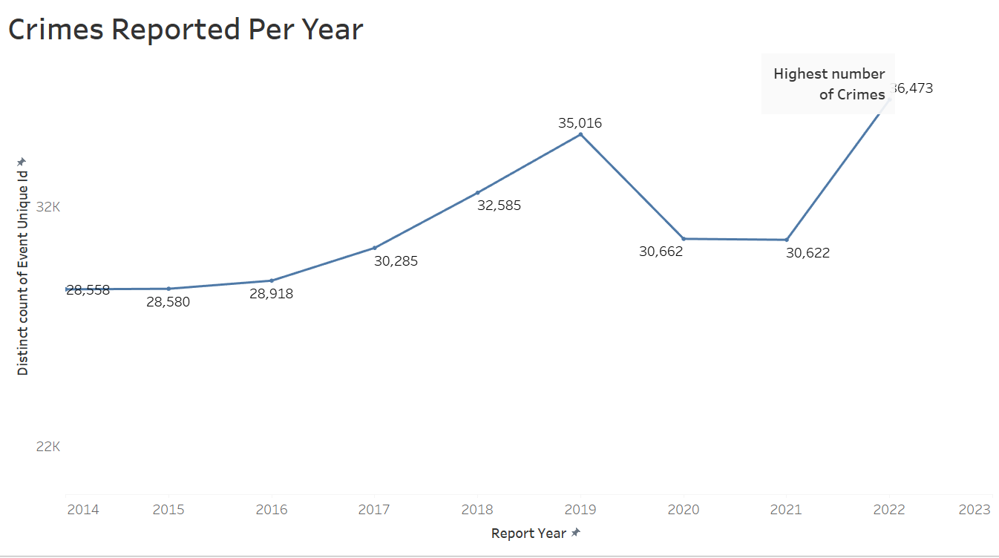
Peaks and lows of the crime rate
This line graph shows that the highest number of crimes was in 2022 followed by 2019 in the second position. The overall trend of the crime rate is going up since 2014 , except in 2020 and 2021 due to the lockdowns. However, the lowest crime rate was in 2014.

Slide 7
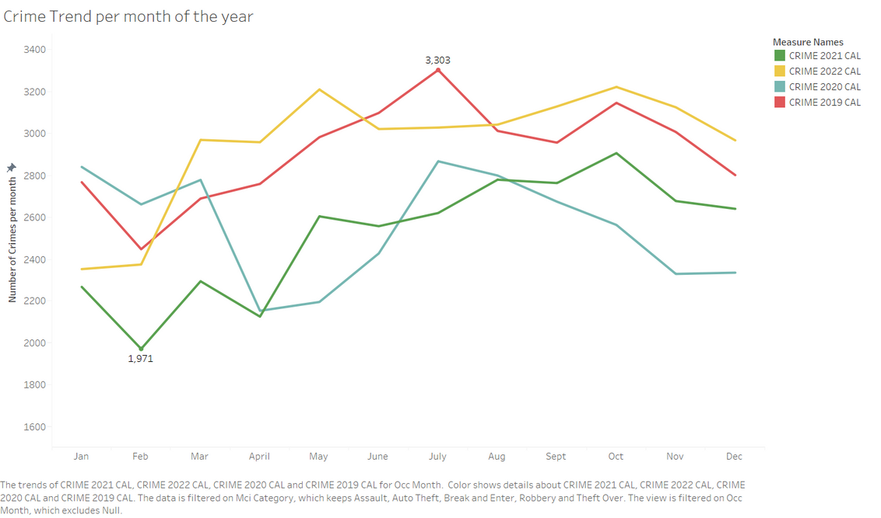

Crime Trend per month of the year
The line graph illustrates the fluctuation of crime rates over four years (2019-2021). It highlights months with varying crime levels. Analyzing the graph, February showcases lower crime, while July indicates the highest incidence, with 1,971 and 3,303 cases respectively.

Slide 8
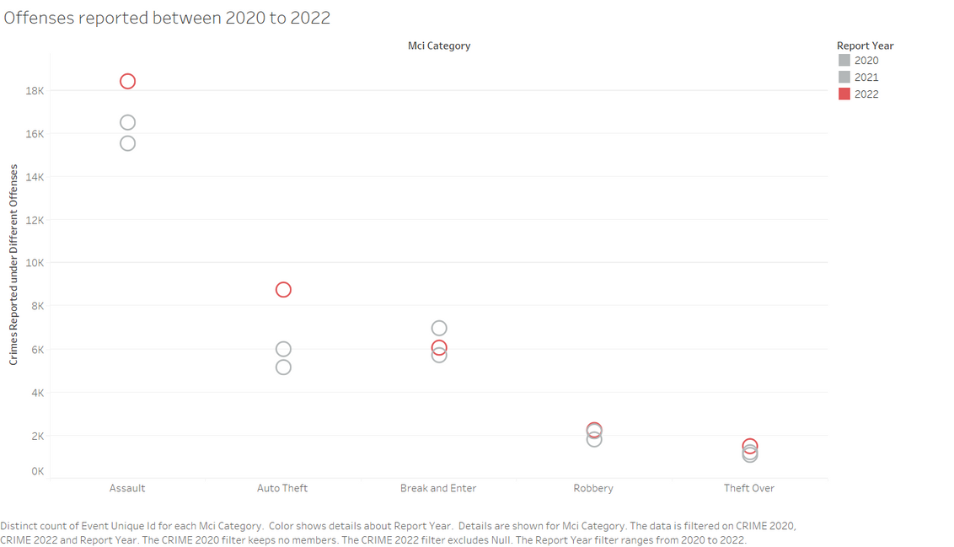
Offenses reported between 2020 to 2022
Assault cases increased significantly in 2022 and continued to rise for three years. Break-ins peaked in 2021 and fell to 6,000 in 2022, while auto theft showed a significant divergence after that year. Robberies remained consistent at around 1800-2000 per year, while theft incidents remained largely unchanged.

Slide 9
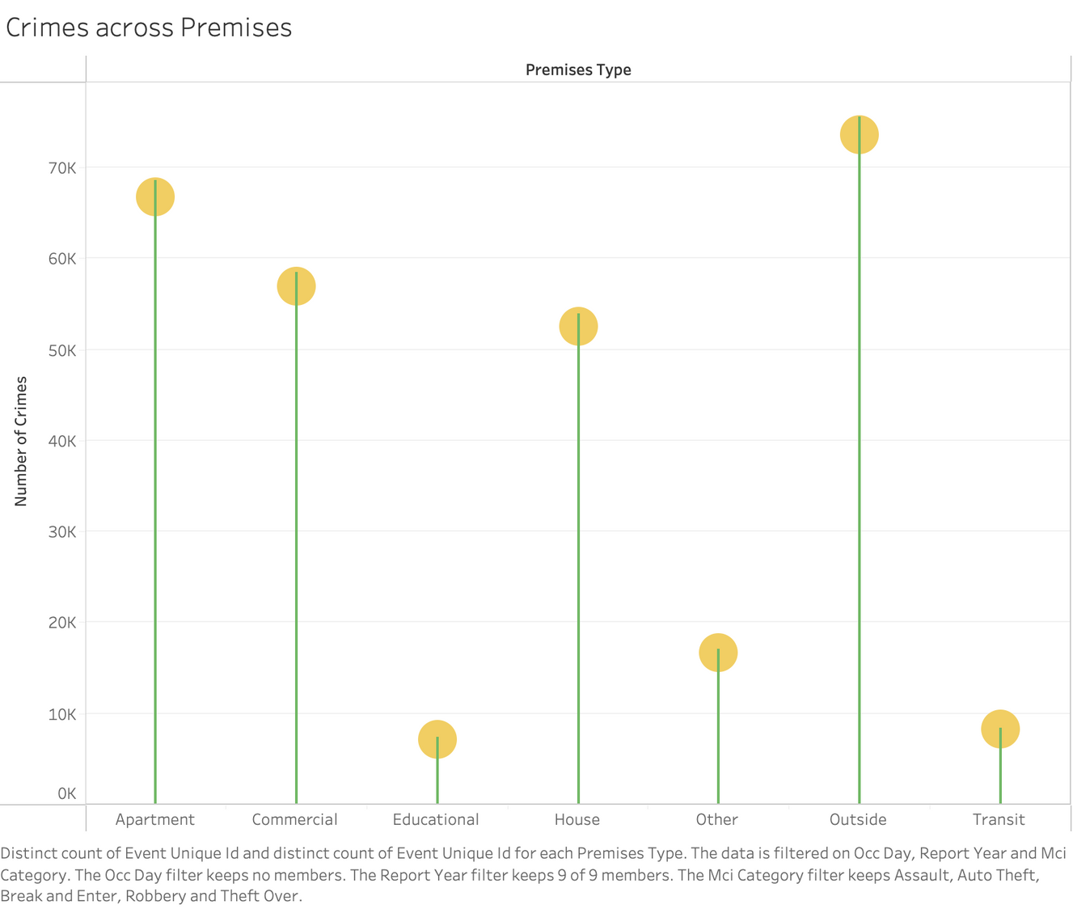
Which premises are most vulnerable?
The chart displays the number of crimes from 2014 to 2022, with the most crimes occurring outside public areas. This could be due to people being distracted and unaware of their surroundings. Educational institutes have the lowest crime rates due to controlled access.

Slide 10
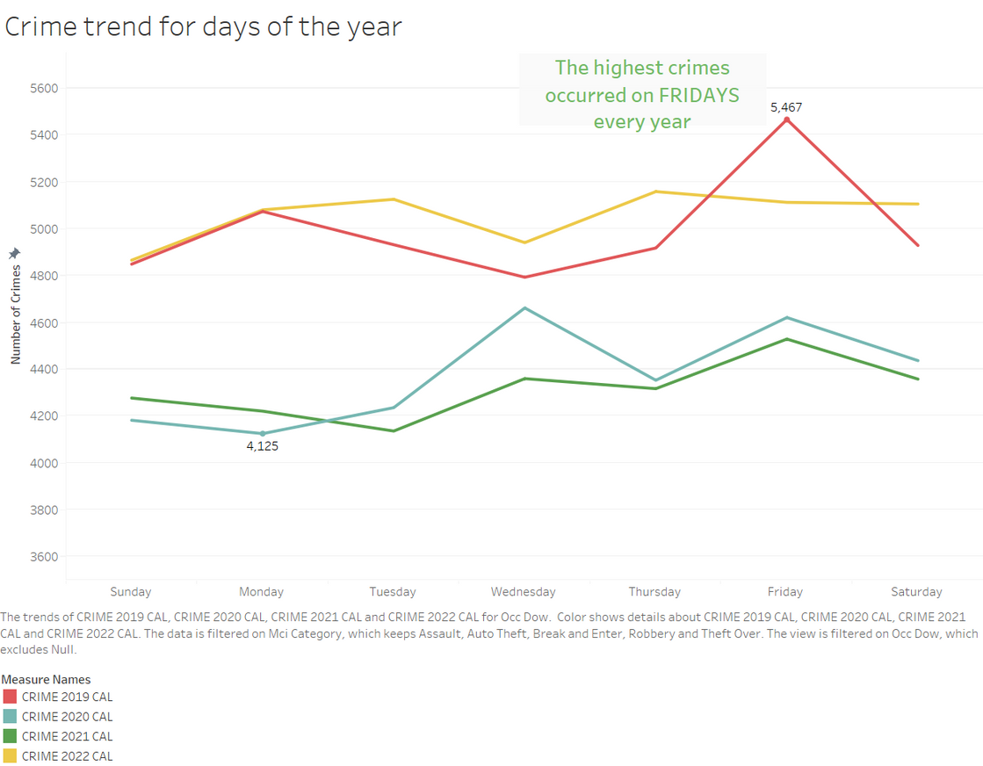
Crime trend for days of the year
Over a four-year period, Fridays had the highest number of reported crimes in 2019, reaching 5,467, while Mondays had the lowest count. In 2021, there were 4,125 reported crimes on Mondays.

Slide 11
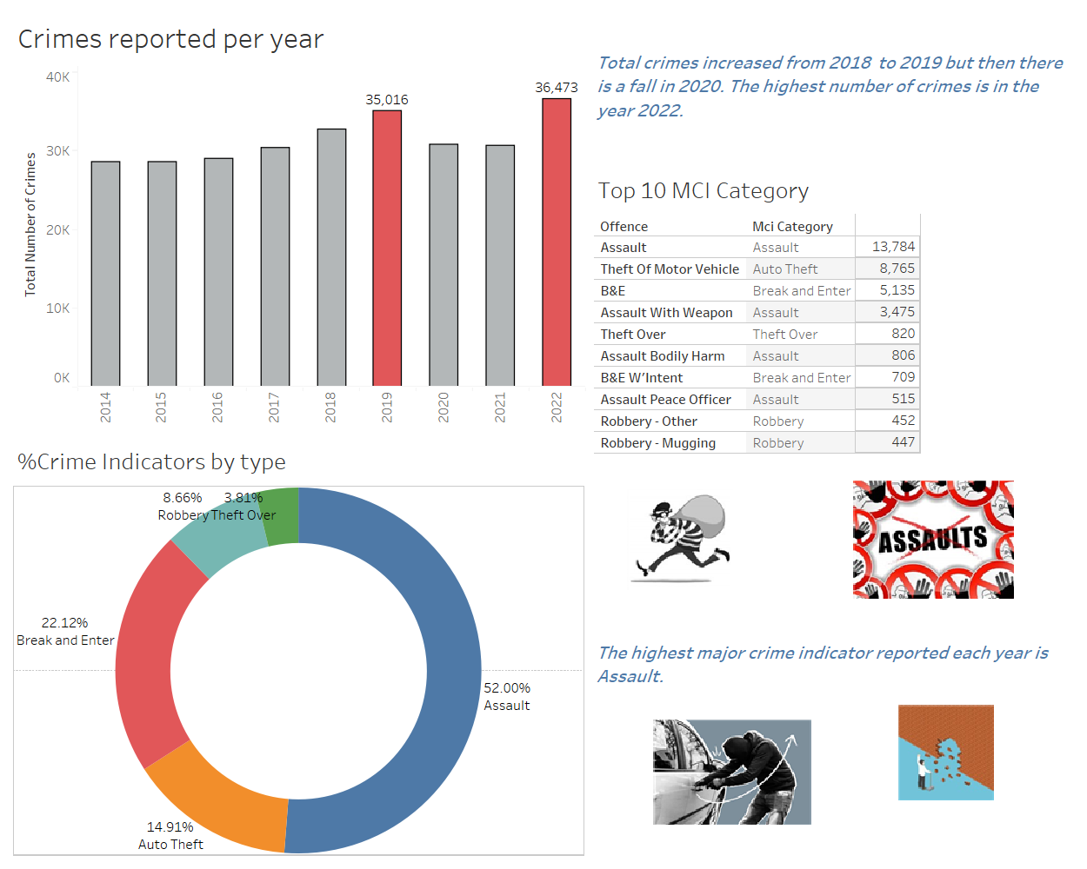
Recommendations
Crime rates typically increase over time, but pandemic lockdowns may cause a decline in 2020. However, 2022 is projected to have higher crime rates than 2019. To prevent crimes like assault and car theft, police operations such as patrolling should be strengthened. The Toronto Police can also raise awareness among citizens and increase their presence in problematic areas.

Slide 12
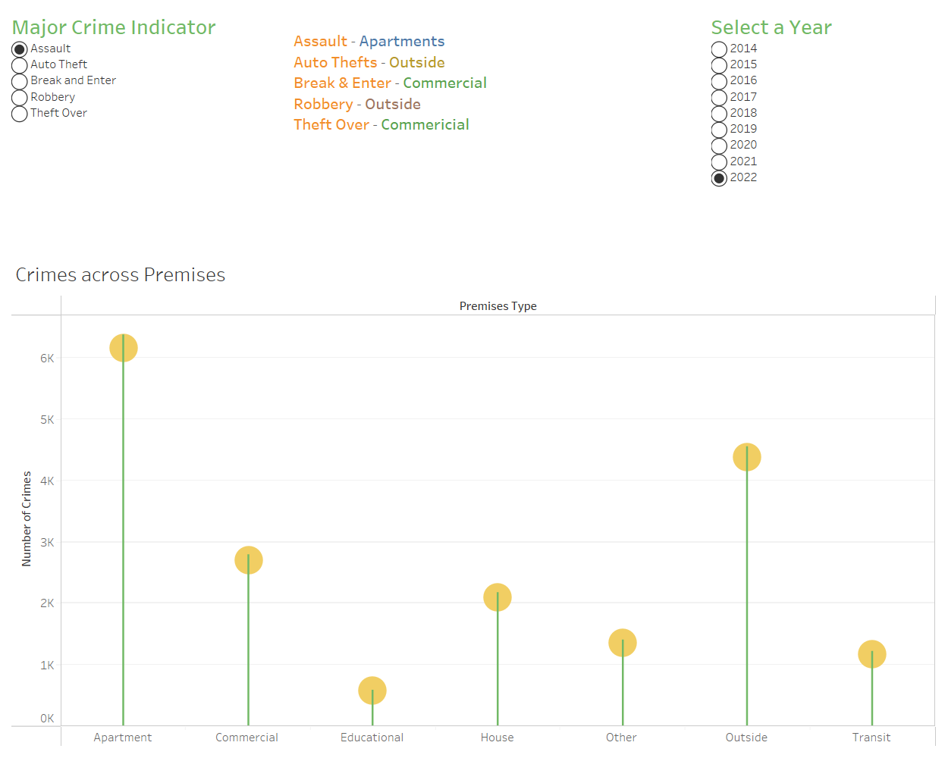
ASSAULT ACROSS PREMISES
In 2022, the majority of assaults took place in apartments, consistent with a trend of higher assault rates in this type of location over the past few years. Conversely, educational centers experienced the lowest incidence of assault.

Slide 13

conclusion
The highest crime rate ever observed in 2022 was noted, reflecting an increase in crimes throughout the years. In contrast to 2019, there was a decline in crime in 2020. The day with the most reported crimes in 2019 was clearly Friday. The most prevalent offences were assault-related, then break-and-enter, motor theft, robbery, and theft over. Schools and universities were the safest locations to be, but apartments had the highest reported crime rates because of things like population density and potential security flaws.

Slide 14

thank you

